Slide 1


Alexandre Nassabay
2023-11-14

Slide 2

Outline
Executive Summary
Introduction
Methodology
Results
Conclusion
Appendix

Slide 3
Executive Summary
Methodologies
Data Collection
Data Wrangling
Data Analysis
Data Visualization
Results

Slide 4
Introduction
Private space exploration market has reached USD 447 billion on 2023 and is expected to reach USD 1 trillion in 2030 (McKinsey and WEF). Several companies can be highlighted, such as Virgin Galactic, providing suborbital spaceflights, Rocket Lab as a small satellite provider, Blue Origin with sub-orbital and orbital reusable rockets, and SpaceX with reusable rockets, satellite deploying and Satellite Internet Provider.
Each SpaceX launch is announced with a cost of 62 million dollars, while other providers cost upwards of 165 million dollars each, much of the savings is because SpaceX can reuse the first stage. Thus, the reusability of the first stage is crucial to company performance.
Studying the SapceX Launch operations we will seek to answer the following questions as benchmark to establish competition with them:
How much each launch will cost?
The first stage will be reused?
The first stage will land successfully?

Slide 5

Section 1

Slide 6
Methodology
Executive Summary
Data collection methodology:
SpaceX API
Web Scraping Wikipedia
Perform data wrangling
Perform exploratory data analysis (EDA) using visualization and SQL
Perform interactive visual analytics using Folium and Plotly Dash
Perform predictive analysis using classification models
How to build, tune, evaluate classification models

Slide 7
Data Collection
SpaceX have an API, open to public use, with information about their launches;
This is not enough data for this analysis, so it was complemented with Web Scraping from Wikipedia’s article about the Falcon 9 spaceship.

Slide 8
Data Collection – SpaceX API
The SpaceX REST API is:
https://api.spacexdata.com/v4/
The script used to retrieve data from SpaceX API is on GitHub.
Libraries Initialization
Get JSON from API
Create dataframe from JSON
Filter Falcon 9 Launchs
Data Wrangling

Slide 9
Data Collection - Scraping
The Wikipedia’s article scraped is:
https://en.wikipedia.org/wiki/List_of_Falcon_9_and_Falcon_Heavy_launches
The script used to scrape data from Wikipedia is on GitHub.
Libraries Initialization
Request page HTML
Parse HTML with BeatifulSoup
Create Dataframe
Data Wrangling

Slide 10
Data Wrangling
The acquired data is not ready for analysis due missing values.
First, we identify the fields thar have incomplete data.
Then we identify if the incomplete fields are relevant for our analysis. If so, it will be treated, else it can be ignored or discarded.
On this dataset Payload Mass and Launchpad have missing data. The Launchpad is not critical, given that the launch sites and their coordinates are known. However, Payload Mass is directed related to the amount of fuel required to mission and the possible reuse of the first stage. The missing values will have to be estimated.

Slide 11
Data Wrangling
The chosen estimate for missing values is the mean value of Payload mass of known launches.
The script used for data wrangling is on GitHub.
Data Retrieving
Identify missing values
Fill missing numeric data with mean value
Create and Export Dataframe
Data Analysis

Slide 12
EDA with SQL
The following queries were performed:
Create table (loading data from the CSV);
Display the names of the unique launch sites in the space mission;
Display 5 records where launch sites begin with the string 'CCA’;
Display the total payload mass carried by boosters launched by NASA (CRS);
Display average payload mass carried by booster version F9 v1.1;
List the date when the first succesful landing outcome in ground pad was achieved;

Slide 13
EDA with SQL
List the names of the boosters which have success in drone ship and have payload mass greater than 4000kg but less than 6000kg;
List the total number of successful and failure mission outcomes;
List the names of the booster_versions which have carried the maximum payload mass. Use a subquery;
List the records which will display the month names, failure landing_outcomes in drone ship ,booster versions, launch_site for the months in year 2015;
Rank the count of landing outcomes (such as Failure (drone ship) or Success (ground pad)) between the date 2010-06-04 and 2017-03-20, in descending order;
The script used for exploratory data analysis with SQL is on GitHub.

Slide 14
EDA with Data Visualization
The following charts types were used:
Scatterplots – They are a good tool to identify correlation between variables.
Payload Mass vs Flight Number;
Launch Site vs Flight Number;
Launch Site vs Payload Mass;
Mission Success (Class) vs Mission Orbit;
Mission Orbit vs Flight Number;
Mission Orbit vs Payload Mass;

Slide 15
EDA with Data Visualization
Bar graphs – The are good to represent relationships envolving cathegorical variables.
Mission Success (Class) vs Mission Orbit;
Line graphs – They are used to visualize trends on numerical data.
Mission Success (Class) vs Launch Date;
The script used for exploratory data analysis with data visualization is on GitHub.

Slide 16
Build an Interactive Map with Folium
Folium is a library for geospatial data analysis. Its main object is a map where your data will be projected with help of another objects:
Marker: this object pinpoints places of interest. In this analysis each mark represents a launch; Markers on a green color indicates a successful mission, while markers on red represent a failure;
Mark Cluster: this object groups markers that are associates with the same place. The launch markers were clustered to their respective launch sites;
Circles: Multifunctional visual indicators. If scaled with map, can represent an action radius or area. On this case they point where the launch sites and were mission command center are in place of markers;
Lines: Multifunctional visual indicators. If scaled with map, can represent distance or scale. On this case they were use as a distance indicator between two anchor markers;
Explain why you added those objects
The script used for representing geospatial data with Folium is on GitHub.

Slide 17
Build a Dashboard with Plotly Dash
A dashboard summarizing success data for the launches were made, containing the following plots:
Pie chart: Show the percentage of success and failure of the site selected on dropdown menu; If the option “All sites” is selected, the pie will show the contribution of each site to the total of successful missions;
Scatter plot: Shows the correlation among Success Rate of missions (Class) vs the Payload Mass, color-coded to the booster used as first stage. The data can be filtered for payload mass range between 0kg and 10000kg, in intervals of 1000kg and by the launch site dropdown as well.

Slide 18
Build a Dashboard with Plotly Dash
This plots allow to explore the following questions:
Which site has the largest fraction of successful launches? (KSC LC-39A)
Which site has the highest launch success rate? (KSC LC-39A)
Which payload range(s) has the highest launch success rate? (3000kg to 4000kg with 70% of success)
Which payload range(s) has the lowest launch success rate? (6000kg to 7000kg with no successful mission so far)
Which F9 Booster version (v1.0, v1.1, FT, B4, B5, etc.) has the highest launch success rate? (B5 with 100%, but only one flight so it can be taken as outlier. FT has 65% success rate and 20 missions attempted in total)
The script used for representing geospatial data with Folium is on GitHub.

Slide 19
Predictive Analysis (Classification)
One of our goals is to predict if the first stage of rocket will land successfully. The following models will be used to tack this question:
Logistic Regression;
Support Vector Machine;
Decision Tree;
K-Nearest Neighbors;

Slide 20
Predictive Analysis (Classification)
Summarize how you built, evaluated, improved, and found the best performing classification model
You need present your model development process using key phrases and flowchart
Add the GitHub URL of your completed predictive analysis lab, as an external reference and peer-review purpose

Slide 21
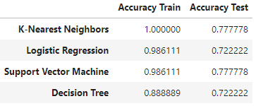
Predictive Analysis (Classification)
All the models were submitted to the workflow depicted on right.
Model Setup
Data Standardization and Normalizaion
Train / Test split of Dataset
Model training Wirth Grid Search Optimization
Data Prediction and Accuracy Tests
The script used for data classification is on GitHub.

Slide 22
Results
Exploratory data analysis results
Interactive analytics demo in screenshots
Predictive analysis results

Slide 23

Section 2

Slide 24
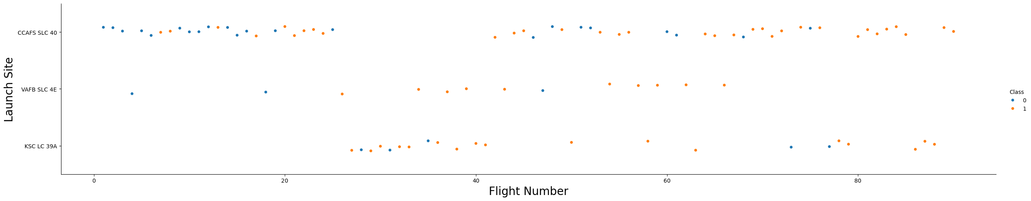
Flight Number vs. Launch Site
There is no special correlation between launch site and flight number;
Success rate increased over time;

Slide 25
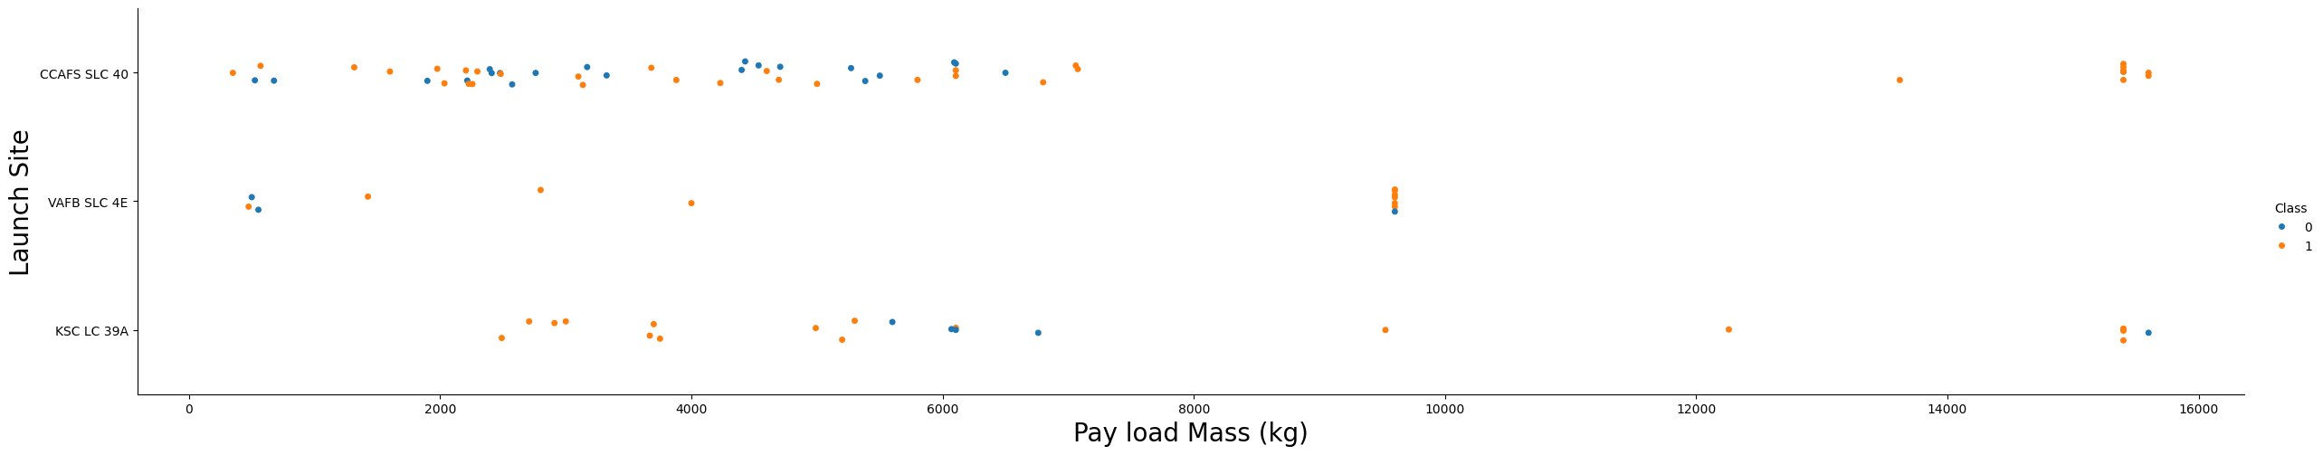
Payload vs. Launch Site
Launch site WAFB SLC 4E seems to be limited to payloads below 10000kg;
KSC LC 39A seems to handle better smaller payloads;

Slide 26
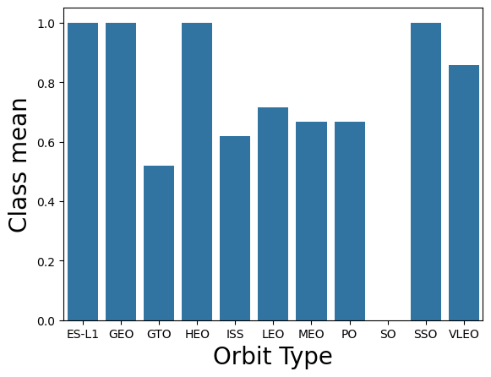
Success Rate vs. Orbit Type
The orbits with higher altitude are usually associate with more expensive payloads and, consequently, tighter procedures, which may exclude booster reuse. This might be a fator in their better success rate.

Slide 27
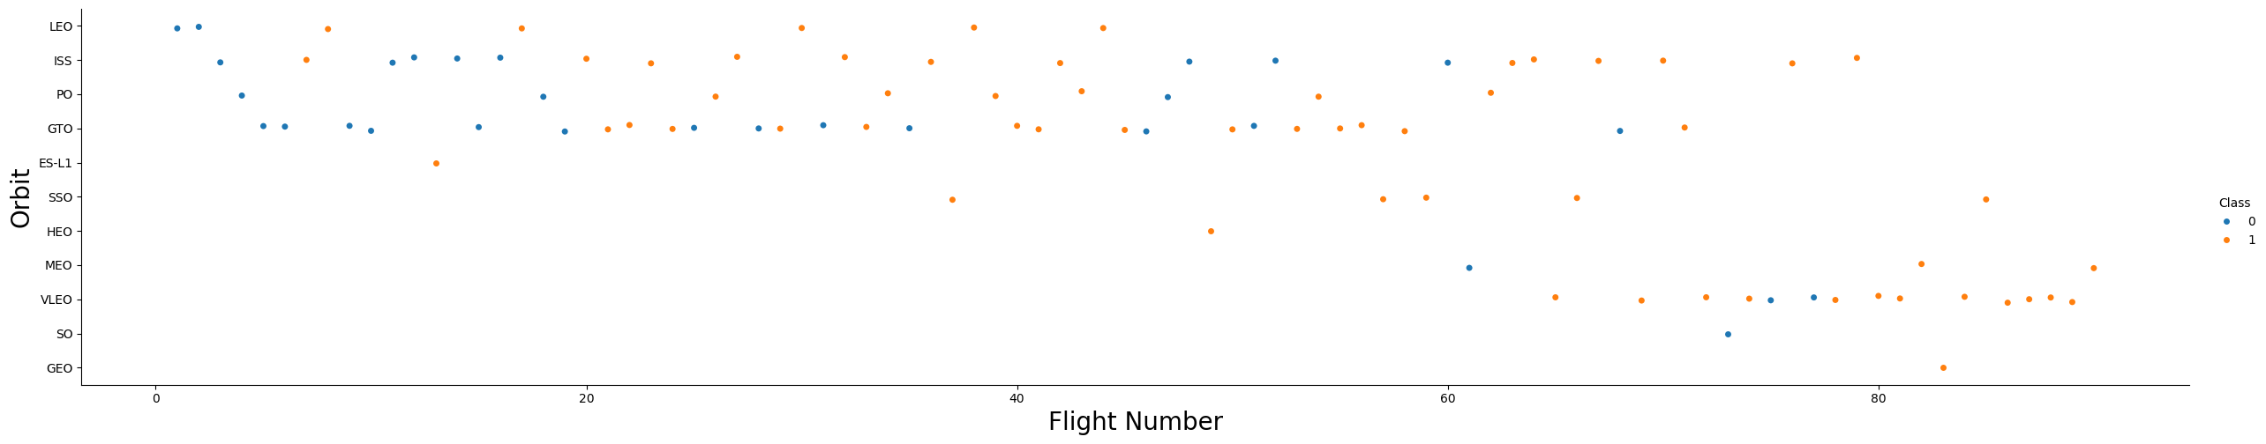
Flight Number vs. Orbit Type
Overall success rate increase for all mission orbits;
Similar conditions may allow transfer knowledge from one type of mission to another;

Slide 28
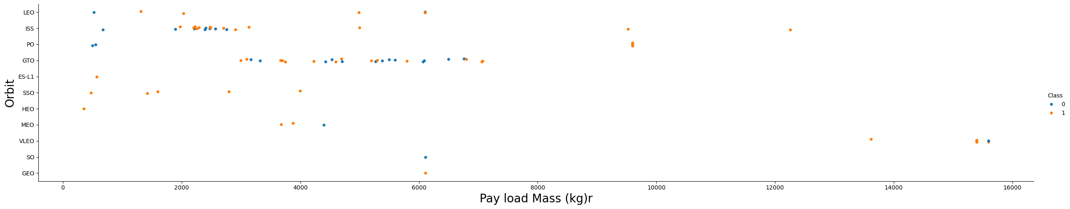
Payload vs. Orbit Type
Heavier payloads have in general higher success rate, in special LEO, ISS and PO;

Slide 29
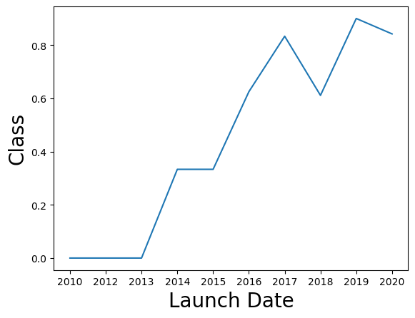
Launch Success Yearly Trend
We can see clearly the result of the knowledge accumulated with all launches as success rate increases with time;
It’s also visible the diminishing returns on success rate increase;

Slide 30
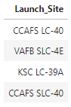
All Launch Site Names
SQL Query:
%sql SELECT DISTINCT "Launch_Site" FROM SPACEXTABLE
Explanation:
The DISTINCT keyword forces the query to return results with no repetitions.
Query Result:

Slide 31
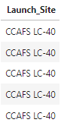
Launch Site Names Begin with 'CCA'
SQL Query:
%sql SELECT "Launch_Site" FROM SPACEXTABLE WHERE "Launch_Site" LIKE "CCA%" LIMIT 5
Explanation:
The LIKE keyword limits the query to return results with "CCA%" charcaters, with “%” acting as a wildcard.
Query Result:

Slide 32
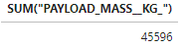
Total Payload Mass
SQL Query:
%sql SELECT SUM("PAYLOAD_MASS__KG_") FROM SPACEXTABLE WHERE "Customer" == "NASA (CRS)"
Explanation:
The SUM keyword totalizes the content of the PAYLOAD_MASS__KG_ column and the WHERE "Customer" == "NASA (CRS)“ clause limits the query to the desired Costumer.
Query Result:

Slide 33
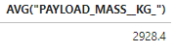
Average Payload Mass by F9 v1.1
SQL Query:
%sql SELECT AVG("PAYLOAD_MASS__KG_") FROM SPACEXTABLE WHERE "Booster_Version" == "F9 v1.1"
Explanation:
The AVG keyword averages the content of the PAYLOAD_MASS__KG_ column and the WHERE "Booster_Version" == "F9 v1.1" clause limits the query to the desired Booster.
Query Result:

Slide 34
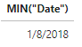
First Successful Ground Landing Date
SQL Query:
%sql SELECT MIN("Date") FROM SPACEXTABLE WHERE "Landing_Outcome" == "Success (ground pad)"
Explanation:
The MIN keyword picks the smallest, i.e., the earliest value of Date column and the WHERE "Landing_Outcome" == "Success (ground pad)" clause limits the query to the successful missions on ground pad.
Query Result:

Slide 35
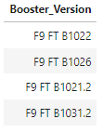
Successful Drone Ship Landing with Payload between 4000 and 6000
SQL Query:
%sql SELECT DISTINCT "Booster_Version" FROM SPACEXTABLE WHERE "Landing_Outcome" == "Success (drone ship)" AND "PAYLOAD_MASS__KG_" > 4000 AND "PAYLOAD_MASS__KG_" < 6000
Explanation:
The DISTINCT keyword forces the query to return results with no repetitions. The WHERE "Landing_Outcome" == "Success (drone ship)" AND "PAYLOAD_MASS__KG_" > 4000 AND "PAYLOAD_MASS__KG_" < 6000 clause limits the query to Palyload mass range for the successful missions on drone ship.
Query Result:

Slide 36
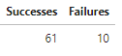
Total Number of Successful and Failure Mission Outcomes
SQL Query:
%%sql SELECT (SELECT COUNT("Landing_Outcome") FROM SPACEXTABLE WHERE "Landing_Outcome" LIKE "Success%") AS Successes,\
(SELECT COUNT("Landing_Outcome") FROM SPACEXTABLE WHERE "Landing_Outcome" LIKE "Failure%") AS Failures
Explanation:
We have a subquery to count every landing success and another subquery to count every landing failure.
Query Result:

Slide 37
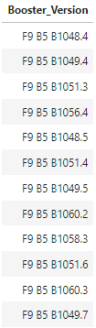
Boosters Carried Maximum Payload
SQL Query:
%sql SELECT DISTINCT "Booster_Version" FROM SPACEXTABLE WHERE "PAYLOAD_MASS__KG_“ = (SELECT MAX("PAYLOAD_MASS__KG_") FROM SPACEXTABLE)
Explanation:
We have a subquery to find the maximum payload carried, while main query picks each distinct booster that reached tis limit.
Query Result:

Slide 38
2015 Launch Records
SQL Query:
%sql SELECT \
CASE \
WHEN (substr("Date", -7, 2) = '01' OR substr("Date", -7, 2) = '/1') THEN 'January' \
WHEN (substr("Date", -7, 2) = '02' OR substr("Date", -7, 2) = '/2') THEN 'February' \
WHEN (substr("Date", -7, 2) = '03' OR substr("Date", -7, 2) = '/3') THEN 'March' \
WHEN (substr("Date", -7, 2) = '04' OR substr("Date", -7, 2) = '/4') THEN 'April' \
WHEN (substr("Date", -7, 2) = '05' OR substr("Date", -7, 2) = '/5') THEN 'May' \
WHEN (substr("Date", -7, 2) = '06' OR substr("Date", -7, 2) = '/6') THEN 'June' \
WHEN (substr("Date", -7, 2) = '07' OR substr("Date", -7, 2) = '/7') THEN 'July' \
WHEN (substr("Date", -7, 2) = '08' OR substr("Date", -7, 2) = '/8') THEN 'August' \
WHEN (substr("Date", -7, 2) = '09' OR substr("Date", -7, 2) = '/9') THEN 'September' \
WHEN (substr("Date", -7, 2) = '10') THEN 'October' \
WHEN (substr("Date", -7, 2) = '11') THEN 'November' \
WHEN (substr("Date", -7, 2) = '12') THEN 'December' \
ELSE substr("Date", -7, 2) \
END AS "Month of 2015", \
"Landing_Outcome", "Booster_Version" , "Launch_Site" \
FROM SPACEXTABLE \
WHERE substr("Date", -4, 4) = "2015" AND "Landing_Outcome" = "Failure (drone ship)" )

Slide 39
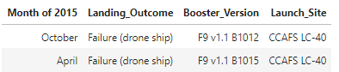
2015 Launch Records
Explanation:
The CASE clause act together with substr() function to parse the data column and properly assign the month.
Query Result:

Slide 40
Rank Landing Outcomes Between 2010-06-04 and 2017-03-20
SQL Query:
%sql SELECT "Landing_Outcome", COUNT("Landing_Outcome") AS "Total" \
FROM \
(SELECT *, \
CASE \
WHEN ("Year" < '2017' AND "Year" > '2010') THEN '1' \
WHEN ("Year" = '2017' AND "Month" < '03') THEN '1' \
WHEN ("Year" = '2017' AND "Month" > '03') THEN '0' \
WHEN ("Year" = '2010' AND "Month" > '04') THEN '1' \
WHEN ("Year" = '2010' AND "Month" < '04') THEN '0' \
WHEN ("Year" = '2017' AND "Month" = '03' AND "Day" <= '30') THEN '1' \
WHEN ("Year" = '2017' AND "Month" = '03' AND "Day" > '30') THEN '0' \
WHEN ("Year" = '2010' AND "Month" = '04' AND "Day" >= '06') THEN '1' \
WHEN ("Year" = '2010' AND "Month" = '04' AND "Day" <6) THEN '0' \
ELSE '0' \
END \
AS "Result" \
FROM \
(SELECT \
"Landing_Outcome", "Date", substr("Date", -4, 4) AS "Year", \
CASE \
WHEN (substr("Date", -7, 2) = '01' OR substr("Date", -7, 2) = '/1') THEN '01' \
WHEN (substr("Date", -7, 2) = '02' OR substr("Date", -7, 2) = '/2') THEN '01' \
WHEN (substr("Date", -7, 2) = '03' OR substr("Date", -7, 2) = '/3') THEN '03' \
WHEN (substr("Date", -7, 2) = '04' OR substr("Date", -7, 2) = '/4') THEN '04' \
WHEN (substr("Date", -7, 2) = '05' OR substr("Date", -7, 2) = '/5') THEN '05' \
WHEN (substr("Date", -7, 2) = '06' OR substr("Date", -7, 2) = '/6') THEN '06' \
WHEN (substr("Date", -7, 2) = '07' OR substr("Date", -7, 2) = '/7') THEN '07' \
WHEN (substr("Date", -7, 2) = '08' OR substr("Date", -7, 2) = '/8') THEN '08' \
WHEN (substr("Date", -7, 2) = '09' OR substr("Date", -7, 2) = '/9') THEN '09' \
ELSE substr("Date", -7, 2) \
END AS "Month", \
CASE \
WHEN (substr("Date", 0, 3) = '01' OR substr("Date", 0, 3) = '1/') THEN '01' \
WHEN (substr("Date", 0, 3) = '02' OR substr("Date", 0, 3) = '2/') THEN '02' \
WHEN (substr("Date", 0, 3) = '03' OR substr("Date", 0, 3) = '3/') THEN '03' \
WHEN (substr("Date", 0, 3) = '04' OR substr("Date", 0, 3) = '4/') THEN '04' \
WHEN (substr("Date", 0, 3) = '05' OR substr("Date", 0, 3) = '5/') THEN '05' \
WHEN (substr("Date", 0, 3) = '06' OR substr("Date", 0, 3) = '6/') THEN '06' \
WHEN (substr("Date", 0, 3) = '07' OR substr("Date", 0, 3) = '7/') THEN '07' \
WHEN (substr("Date", 0, 3) = '08' OR substr("Date", 0, 3) = '8/') THEN '08' \
WHEN (substr("Date", 0, 3) = '09' OR substr("Date", 0, 3) = '9/') THEN '09' \
ELSE substr("Date", 0, 3) \
END AS "Day" \
FROM SPACEXTABLE)) \
GROUP BY "Landing_Outcome" ORDER BY "Total" DESC

Slide 41
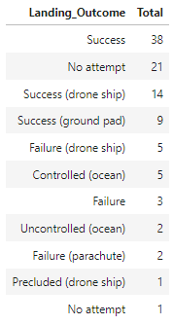
Rank Landing Outcomes Between 2010-06-04 and 2017-03-20
Explanation:
Three subqueries were made. The first limits the year, the second limits the month and the third limits the day. This solution was used because direct date comparison was not working.
Query Result:

Slide 42

Section 3

Slide 43
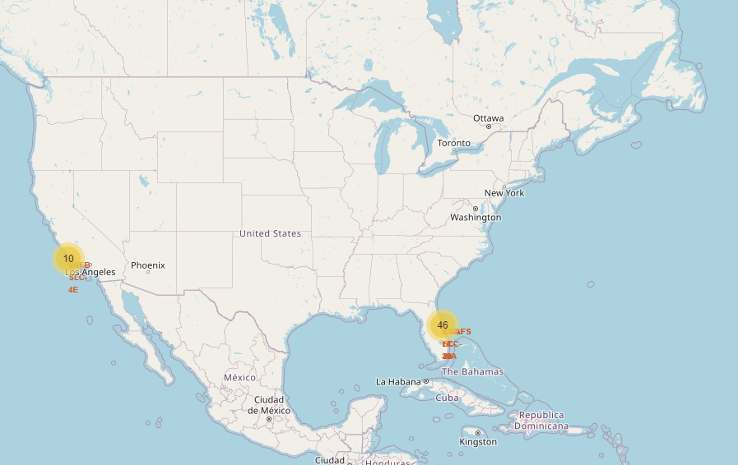
Launch Stations
This maps shows that SpaceX uses launch sites in each US coast.
This location reduces risk of debris hitting inhabited areas in case of failures.
The need of this two locations arise from some missions requiring a retrograde orbit, so they must be launch in opposite direction from prograde orbits. To do this safely you need locations facing ocean from opposite angles.

Slide 44
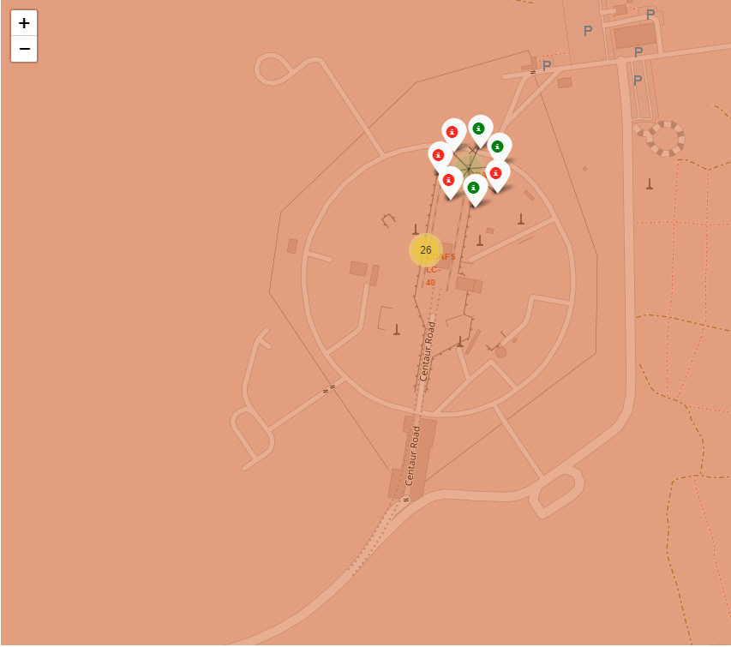
Launch Count Mark Clusters
The map on left show CCAFS LC-40 site and its launch pads, each one have a marker cluster.
When not clicked, the cluster show the number of launches made from there.
When clicked, the cluster explodes the markers indicating success and failures.

Slide 45
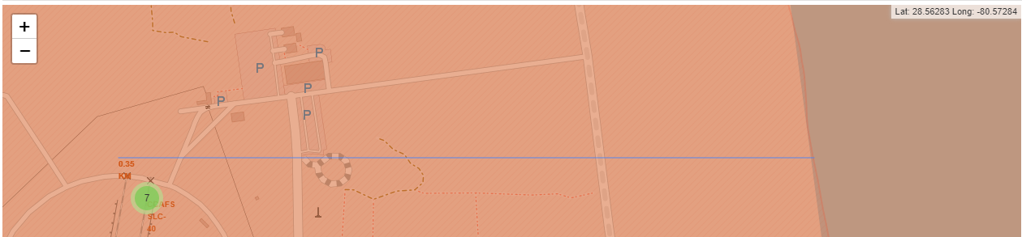
Distance from Points of Interest
The map below shows distance from coastline – about 350m (105 ft)
Besides the pointed importance of open ocean for the launch, other element close to launch sit may be relevant, like large roads and railroad for logistic of heavy loads (rocket themselves not built or serviced on launch sites)

Slide 46

Section 4

Slide 47
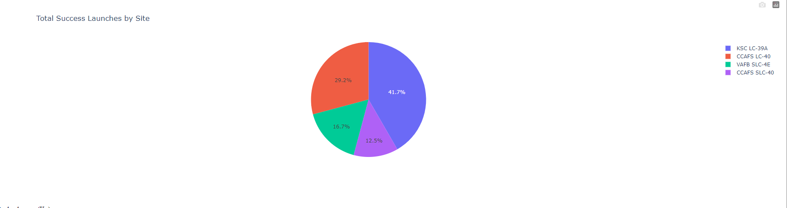
<Dashboard Screenshot 1>
The KSC LC-39A booster have the highest mission success rate.

Slide 48
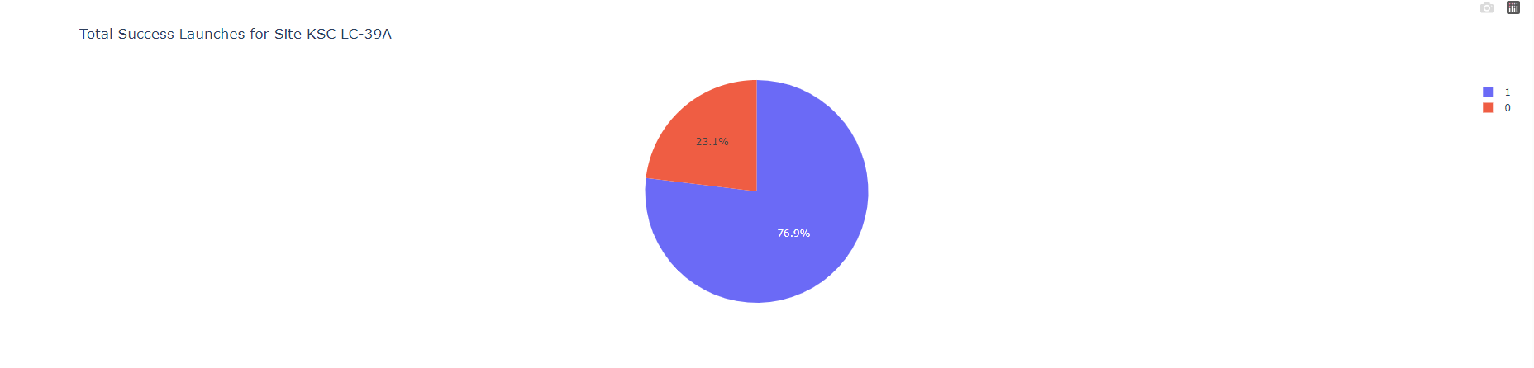
<Dashboard Screenshot 2>
The KSC LC-39A has a 76.9% success rate.

Slide 49
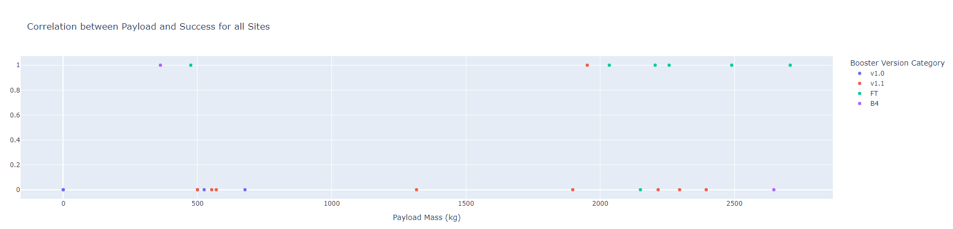
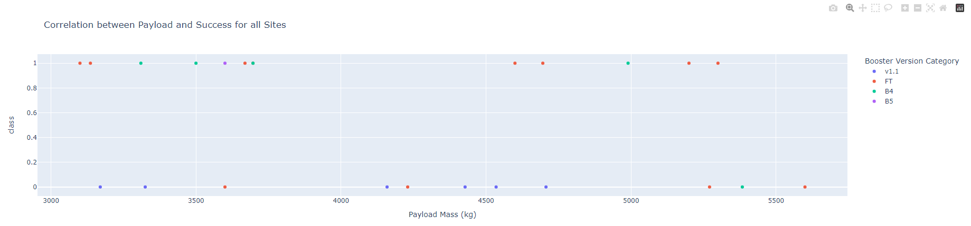
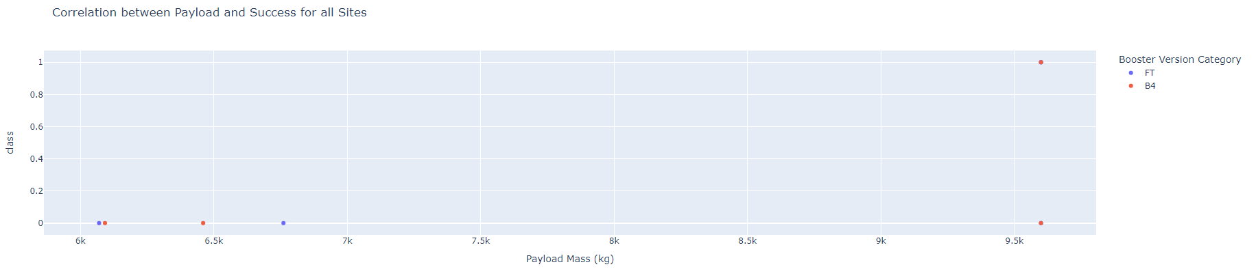
Paylod Correlations

Slide 50
Payload Correlations
Successful mission are concentrated on 2000kg-6000kg, meaning mission on limit of capacity of boosters are more prone to failure.

Slide 51

Section 5

Slide 52
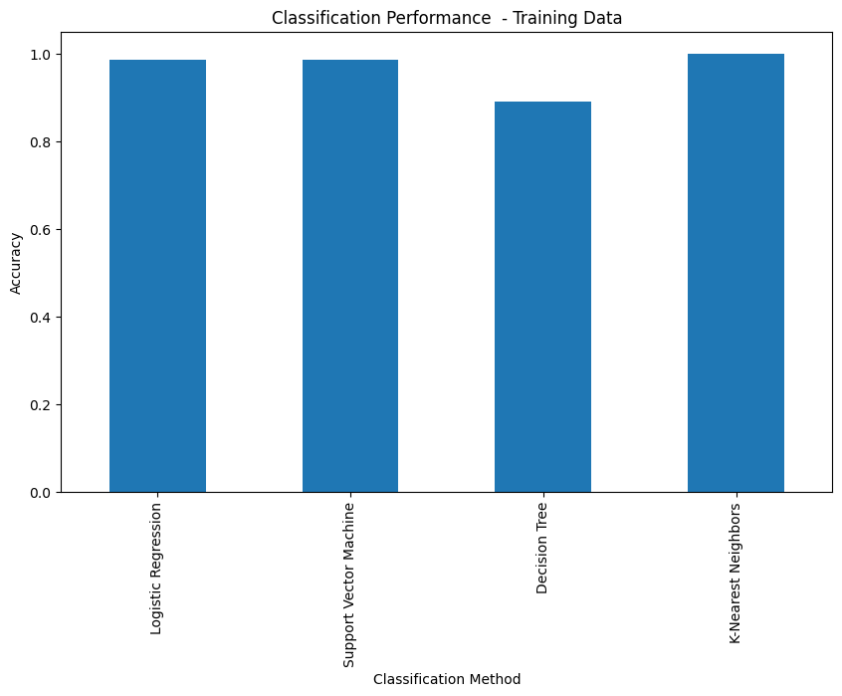
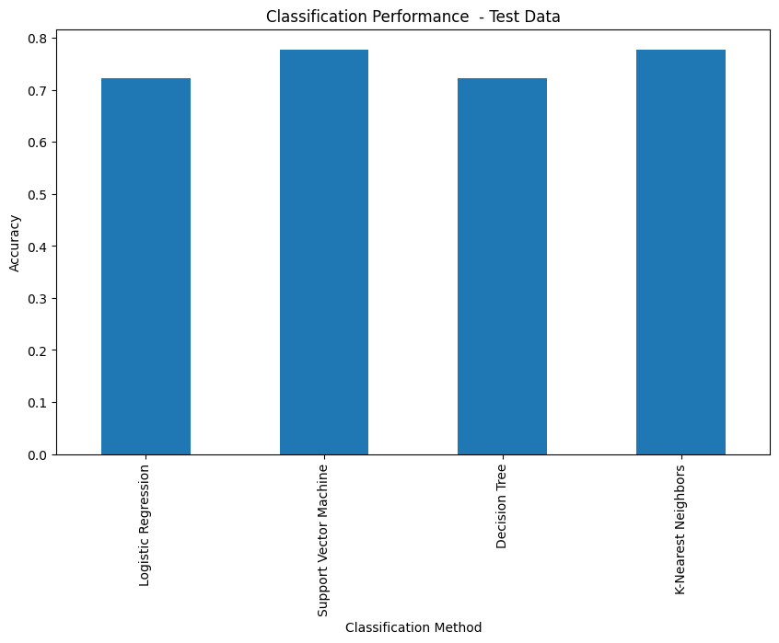
Classification Accuracy
The model with best accuracy is KNN, with train accuracy of 1 and test accuracy with 0,778

Slide 53
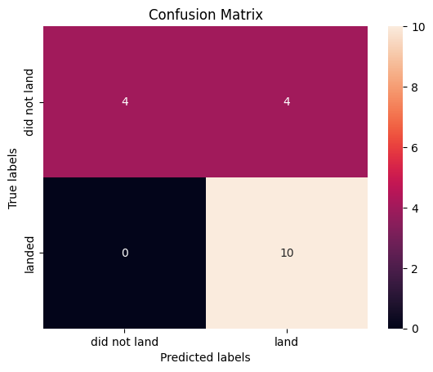
Confusion Matrix
The confusion matrix compares the prediction of a model with the measured data
The matrix points no False Positives and 4 False Negatives, so the model is pessimistic with respect reality

Slide 54
Conclusions
A key factor for mission success is experience in running missions (number of previous attempts);
A higher rate of mission success can be reached if the first stage is not pushed into its lower or higher payload limits;
The gathered data do not explain success rate differences between Launch Sites.
The most performant classification model was KNN with SVM in second, with both having same test accuracy. KNN training accuracy of 1 can be a sign of overfitting, but more test data would be required to discard this model;
This developments allow us to properly predict the success of a booster stage landing;

Slide 55
Appendix
About a prediction of cost launch:
This figures were given previously
SpaceX Launch Cost: USD 62 million
Others Launch Cost: USD 165 million
SpaceX Success Rate (from SQL section): s = 86%
SpaceX Failure Rate (from SQL section): f = 14%

Slide 56
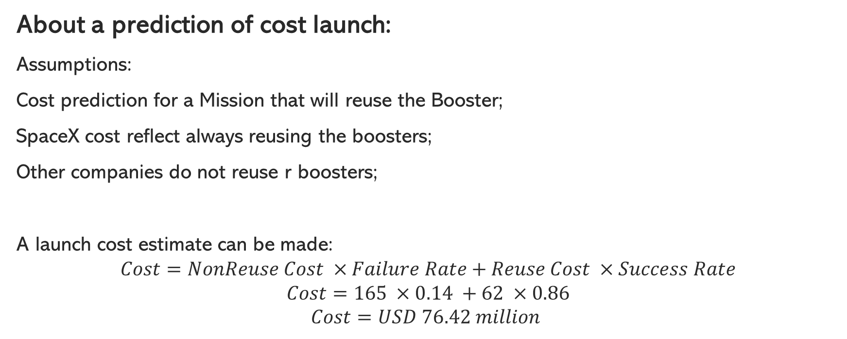
Appendix
About a prediction of cost launch:
Assumptions:
Cost prediction for a Mission that will reuse the Booster;
SpaceX cost reflect always reusing the boosters;
Other companies do not reuse r boosters;
A launch cost estimate can be made:
$$Cost=NonReuse Cost ×Failure Rate+Reuse Cost ×Success Rate$$
$$Cost=165 ×0.14 +62 ×0.86$$
$$Cost=USD 76.42 million$$

Slide 57


